Slide 1
Software Engineering
Requirements Analysis

Slide 2
Software requirement means a requirement that is needed by software to increase the quality of software product.
These requirements are generally a type of expectation of user from software product that is important and need to be fulfilled by software.
Analysis means to examine something in an organized and specific manner to know complete details about it.

Slide 3
Requirements Analysis
Requirements analysis is a set of operations that helps define users' expectations of the application you are building or modifying.
Software engineering professionals sometimes call it requirement engineering, requirements capturing, or requirement gathering.
Requirements analysis involves various tasks that help engineers understand stakeholder demands and explain them in simple and visual ways. It is essential to a software or system project's success.
Notes:
System-Level Software Allocation: This phase involves understanding the high-level requirements of a software system and allocating various software components or modules to different parts of the system. It defines what each part of the system should do in a broad sense.
Software Design: Once the software allocation is complete, the next step is to dive into the details of each allocated software component or module. This involves designing the internal structure of each component, specifying how it will interact with other components, and defining its functionality in detail.

Slide 4
Requirements Analysis
Five (5) Areas of Effort
Gather the requirements
Analyze the requirements
Improve the quality of the requirements
Model the requirements
Document and review the requirements

Slide 5
Gather the Requirements
Conducting interviews
Observing the workplace
Holding focus groups or workshops
Creating requirements lists

Slide 6
Analyze the requirements
In this phase, evaluate system feasibility, and confirm with the quality assurance team that the requirements are testable. The developers make sure the requirements are achievable and understandable.
Necessary
Consistent
Clear and concise
Able to be validated
Complete

Slide 7

Improve the quality of the requirements
Visualization: Use tools such as visualization and simulation that allow stakeholders to better understand the desired end product.
Document dependencies: Document relationships and dependencies among requirements and any assumptions.
Consistent use of templates: Produce consistent templates and models to document the requirements.

Slide 8

Model the requirements
In this phase, it’s time to create models of the requirements, which help stakeholders and customers visualize the potential system
Flowchart
Graphs
Model

Slide 9
Document and review the requirements
You can record the requirements in a document that is easy for both developers and users to understand.
Note the changes your team makes to the requirements throughout the process
Software requirements specification (SRS) - document describes the intended purpose, requirements, and nature of software to be developed
User cases
Process specification

Slide 10
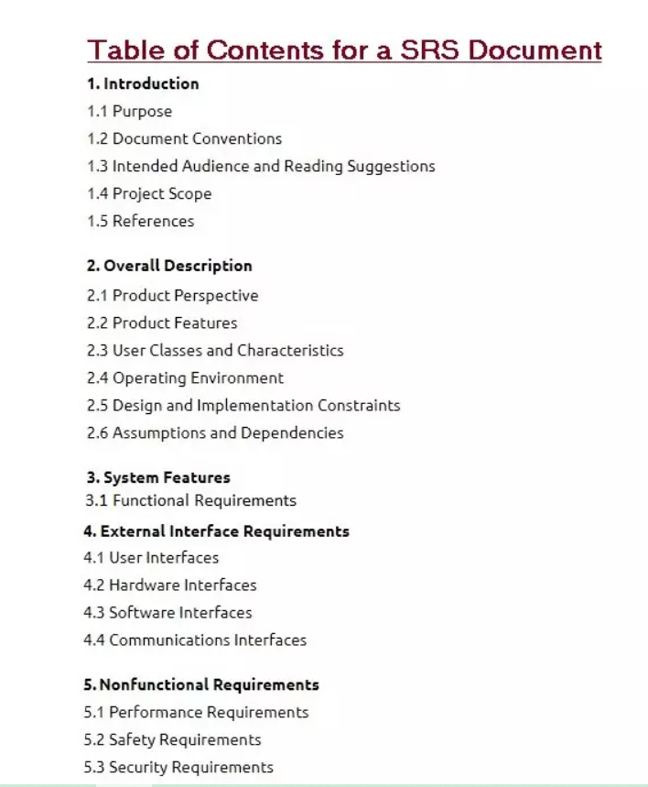
SRS Example

Slide 11
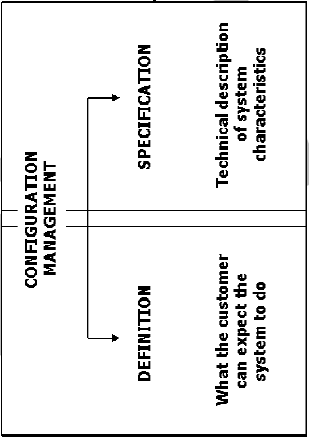
Two sets of requirements

Slide 12
Configuration Management
A set of procedures that track:
the requirements that define a system
the design modules that are generated from the requirements
the program code that implements the design
the tests that verify the functionality of the system
the documents that describe the system

Slide 13
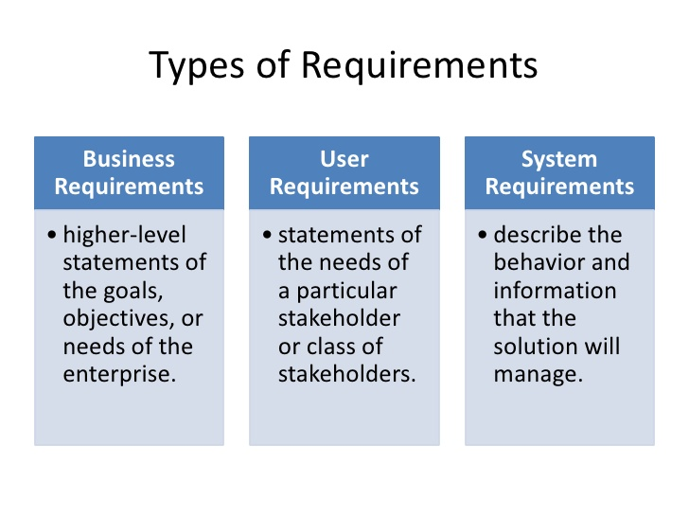
Types of Requirements

Slide 14
Elements of Analysis Model
Objectives
to describe what the customer requires
to establish a basis for the creation of a software design
to define a set of requirements that can be validated once the software is built

Slide 15
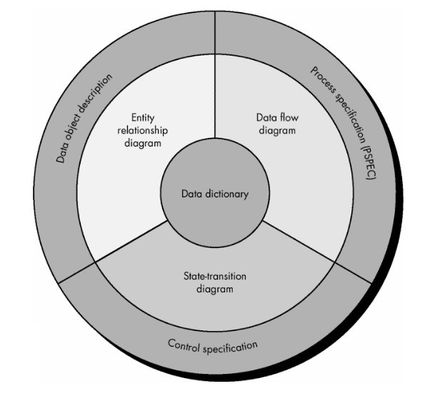
Requirements Analysis: Charts Relationship

Slide 16
Elements of Analysis Model
Data Dictionary
repository containing descriptions of all data objects consumed or produced by the software
Entity-Relationship Diagram (ERD)
depicts relationships between data objects
Data Flow Diagram (DFD)
provides an indication of how data are transformed as they move through the system and depicts the functions (and subfunctions) that transform the data flow
State-Transition Diagram (STD)
indicates how the system behaves as a consequence of external events
Notes:
The data dictionary holds records about other objects in the database, such as data ownership, data relationships to other objects, and other data.
Name of the data item
Aliases
Description/purpose
Related data items
Range of values
Data structure definition/Forms

Slide 17
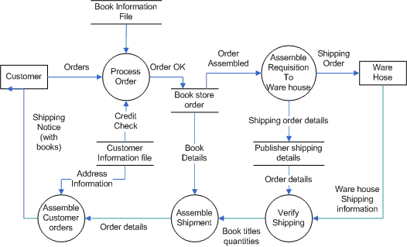
Example: Data Flow Diagram

Slide 18
Software Engineering
Analysis Process

Slide 19
Data Flow Diagram
introduced and popularized for structured analysis and design in the late 1970s (Gane and Sarson 1979)
invented by Larry Constantine, the original developer of structured design, based on Martin and Estrin’s “data flow graph” model of computation

Slide 20
Data Flow Diagram
DFD Conventions
Process
Source/sink
Data flow
Data store
Yourdon/DeMarco

Slide 21
Data Flow Diagram
Steps in developing DFDs
  Make a list of business activities and use it to determine various data flows, processes, data stores, and sources/sinks.
  Create a context diagram that shows sources/sinks and data flows to and from the system.
  Draw Diagram 0 (or Level 1), the next level. Show processes, but keep them general

Slide 22
Data Flow Diagram
  Create a child diagram for each of the processes in Diagram 0 (or Level 1).
  Check for errors and make sure the labels you assign to each process and data flow are meaningful.
  Develop a physical data flow diagram from the logical data flow diagram.
  Partition the physical data flow diagram by separating or grouping parts of the diagram in order to facilitate programming and implementation.

Slide 23
Data Flow Diagram
Level 0 : Context Diagram
Borrower
Books
0.0
Loaned Details
Search Request
Library
Database
System
Borrowed Details
Book Status

Slide 24
Data Flow Diagram
Level 0 : Context Diagram
Academic Department
Schedule data
Enrollment
request
0.0
Class list
Faculty
Member
Course
Registration
System
Student
Schedule

Slide 25
Data Flow Diagram
Level 1: Course Registration System
Enrollment
request
2.0
Academic Department
Enroll
student
Student
Schedule
Student
Schedule
date
Course
enrollment
1.0
Offered
course
Schedule
course
3.0
Class list
Faculty
Member
Produce
class list

Slide 26
Data Flow Diagram
Level 2 : Schedule Course
Course
1.1
1.3
Choose
days and
times
Assign
rooms
Academic Department
Offered
course
Available
rooms
1.2
Assign
faculty
Offered
course
Available
faculty

Slide 27
Data Flow Diagram
Data Flow Rules
  Process
    No process can have only outputs. It is making data from nothing. If an object has only outputs, then it must be a source.
      MIRACLE
    No process can have only inputs. If an object has only inputs, then it must be a sink.
      BLACK HOLE

Slide 28
Data Flow Diagram
  Data Store
    Data cannot move directly from one data store to another data store. Data must be moved by a process.
    Data cannot move directly from an outside source to a data store. Data must be moved by a process that receives data from the source and places the data into the data store.

Slide 29
Data Flow Diagram
  Source/Sink
    Data cannot move directly from a source to a sink. It must be moved by a process if the data are of any concern to our system. Otherwise, the data flow is not shown on the DFD.

